Slide 1
Introduction to Computing for Data Analysis
Logistic regression (classification)
Richard Vuduc, Ph.D.
Associate Professor
School of Computational Science and Engineering
The logistic (sigmoid) function
Notes:
Hey, welcome back.
This lesson is about a particular function that is useful for generating labels that have a probabilistic interpretation.
It’s called the “logistic function,” also known as the “sigmoid function.” Let’s take a look.

Slide 2
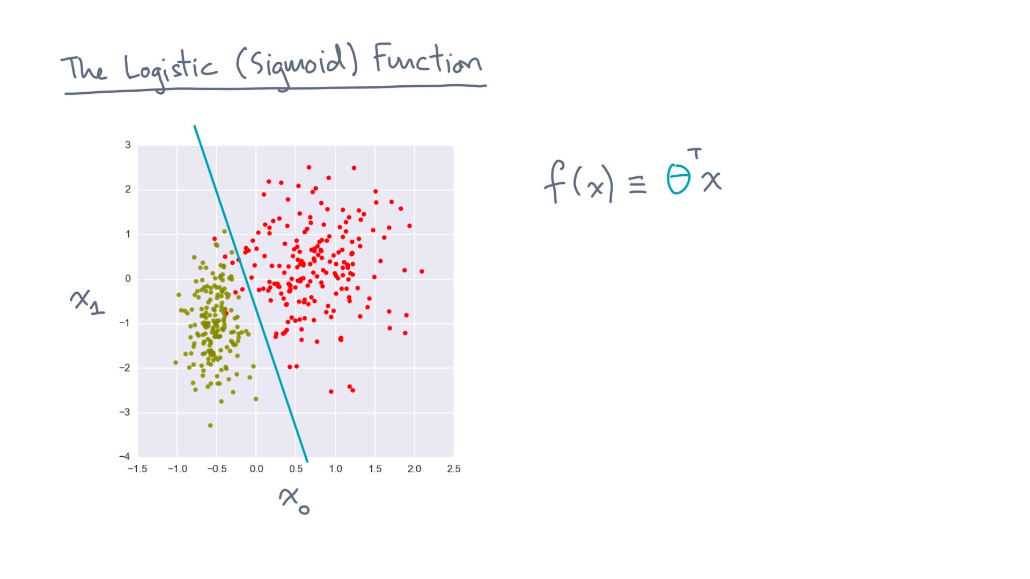
Notes:
Let’s start by recalling the idea of a linear discriminant function, f(x) equals theta-transpose-x.

Slide 3
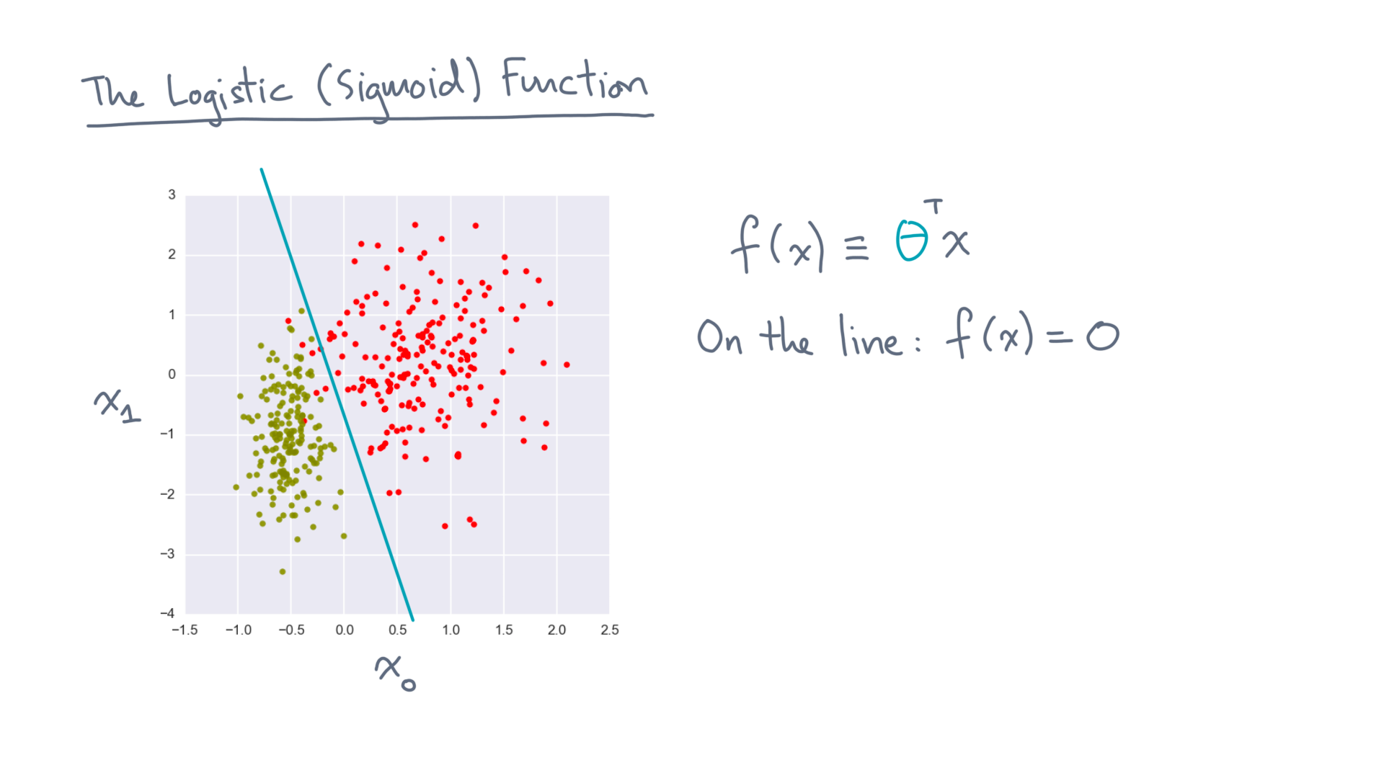
Notes:
We formulated a boundary by setting f(x) equal to zero.

Slide 4
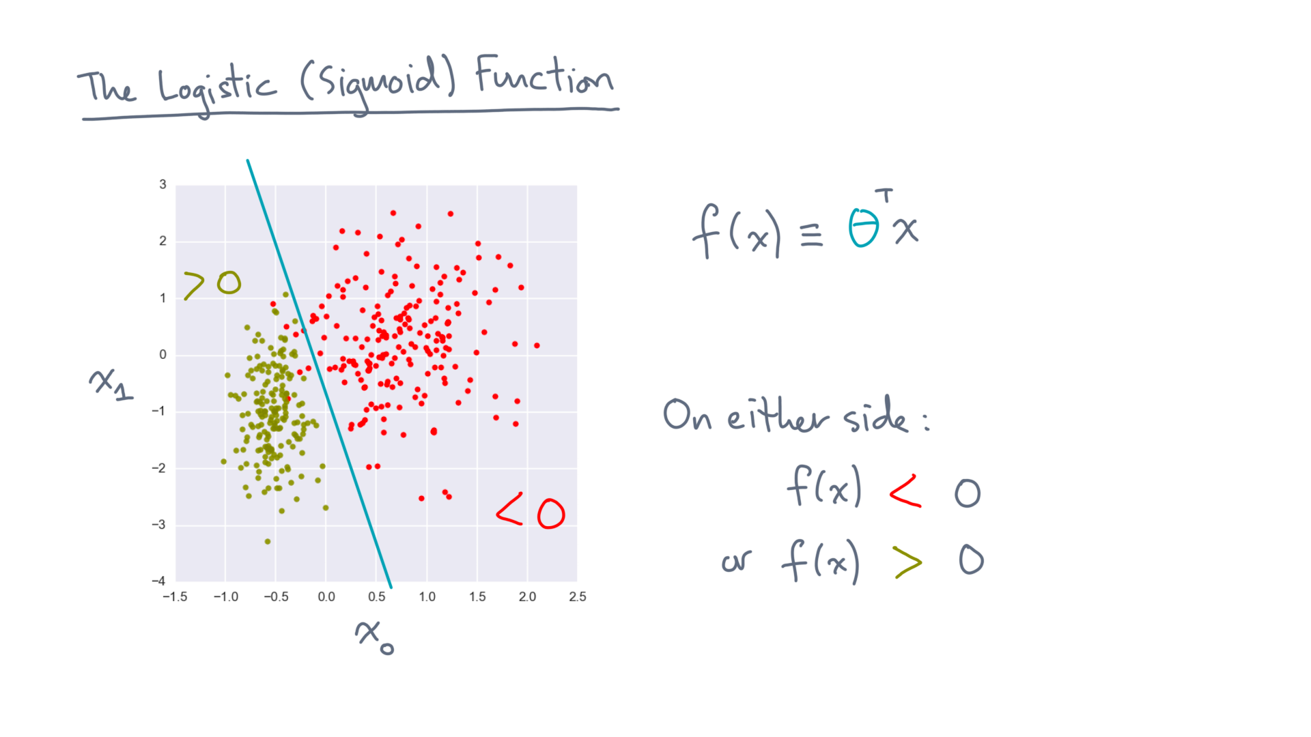
Notes:
Now, the function is positive or negative on either side of that line.

Slide 5
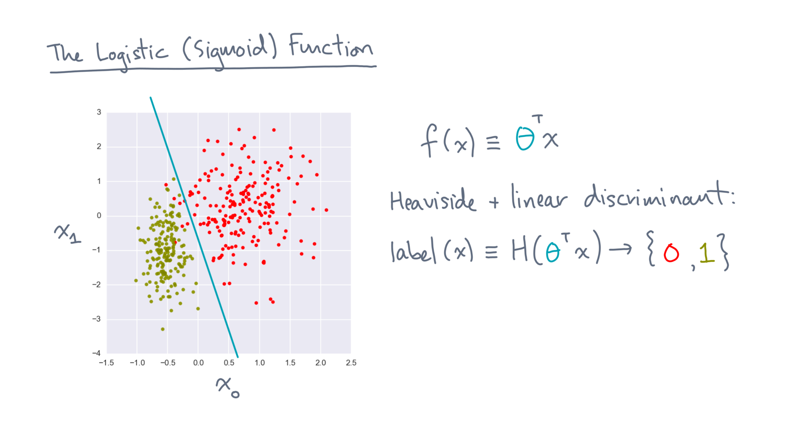
Notes:
So we can use the function to generate labels by choosing an appropriate mapping.
For example, the *Heaviside function*, applied to f, will convert negative values to the label “0” and positive values to “1”.

Slide 6
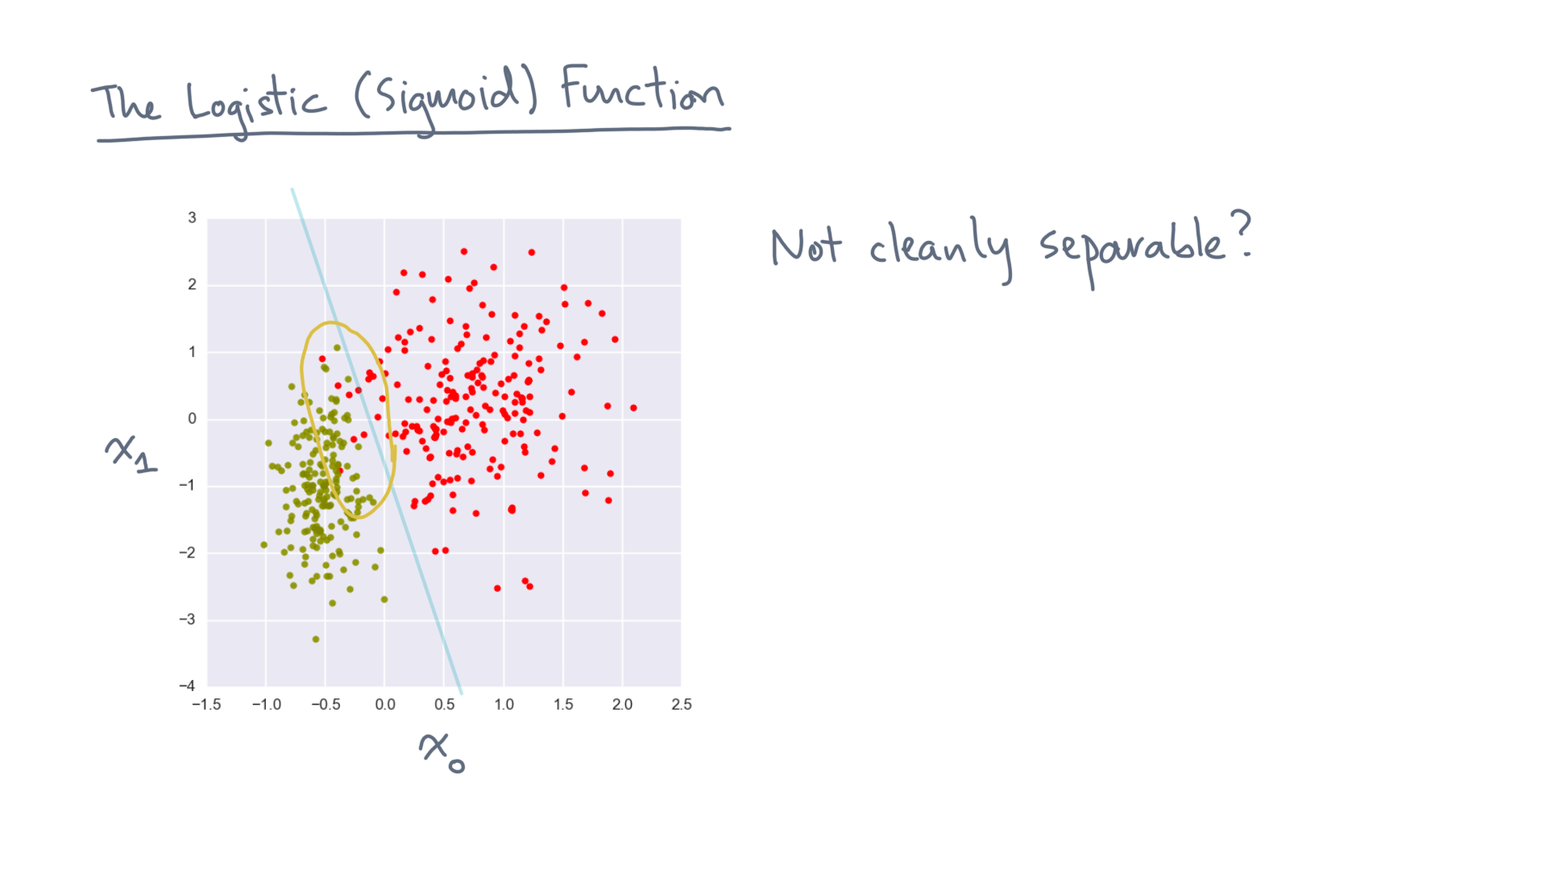
Notes:
One issue is that the Heaviside results in a *hard* assignment of points to labels.
In real life, like this example, the data points are not cleanly separable.

Slide 7
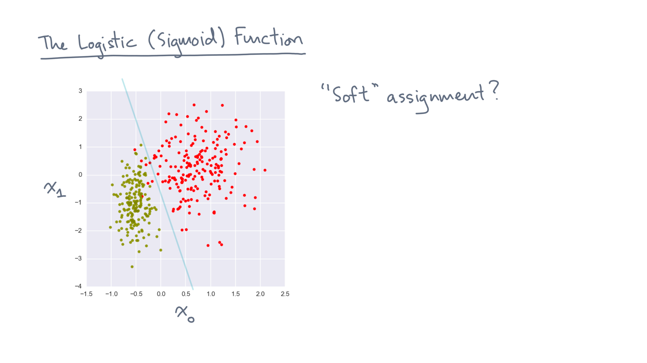
Notes:
We can instead ask whether there is a “soft” assignment?

Slide 8
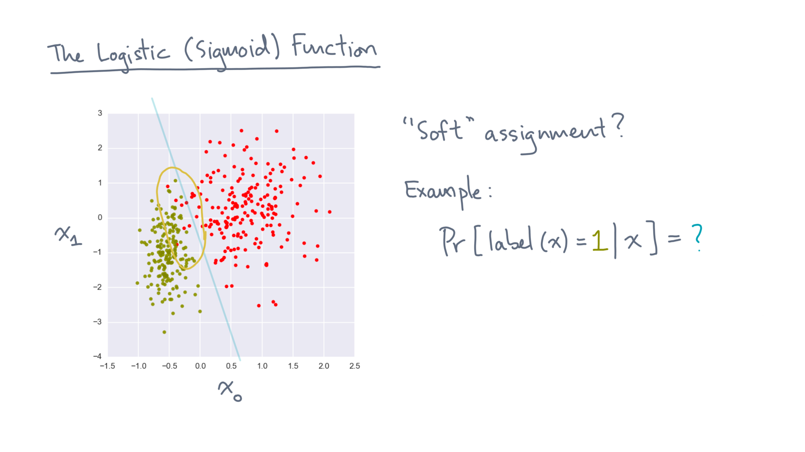
Notes:
For example, instead of assigning a point a label, can we estimate the probability that it has a particular label?
There are many possibilities, but here is one especially useful one,

Slide 9
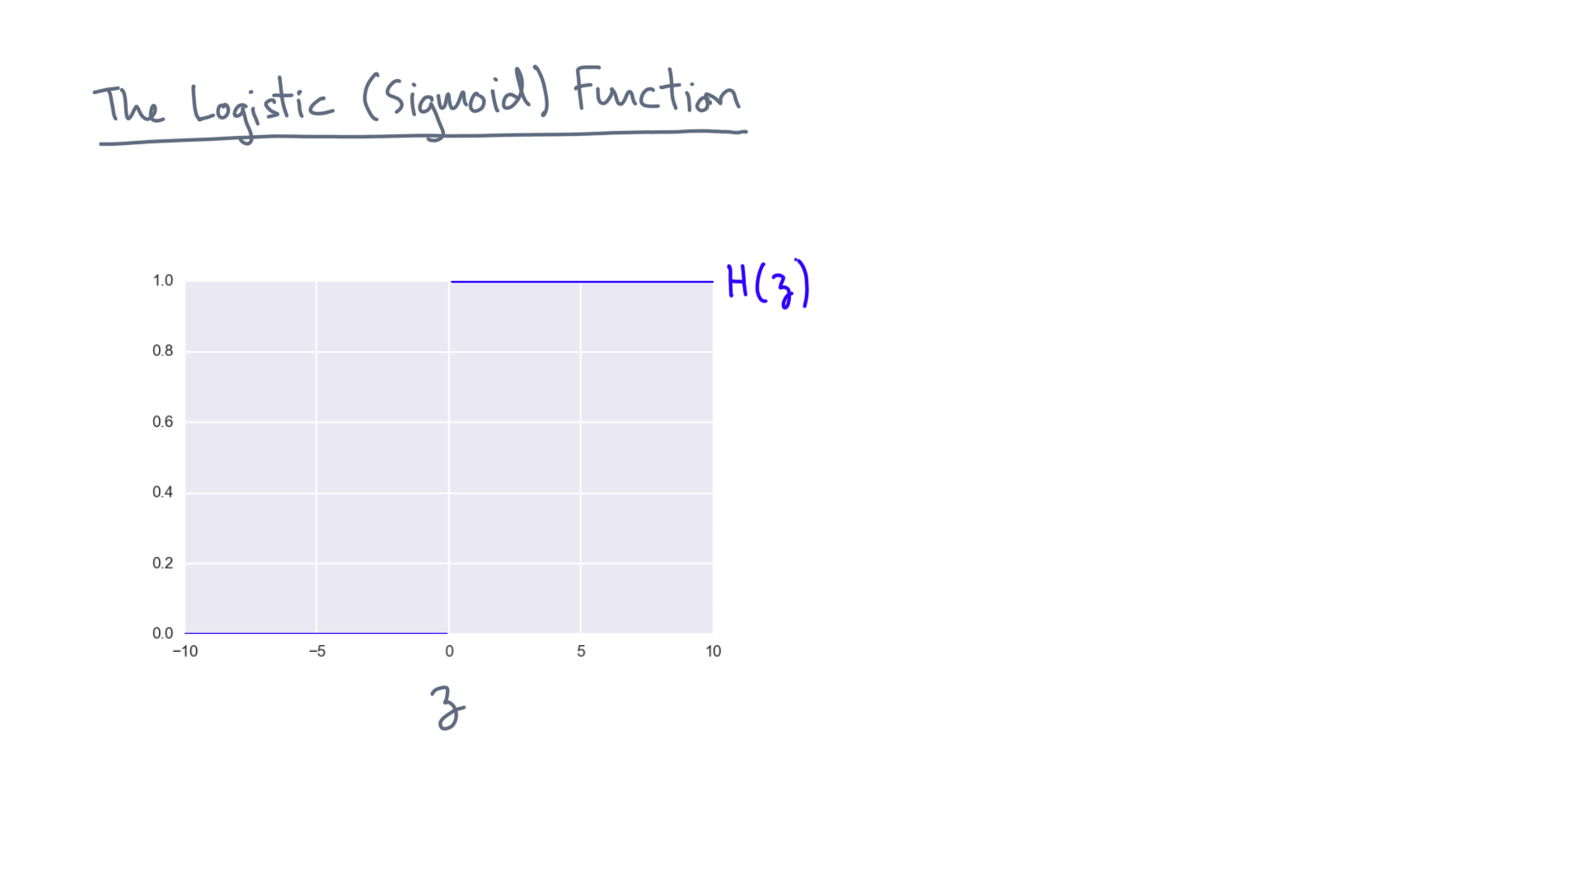
Notes:
First, recall the Heaviside function.

Slide 10
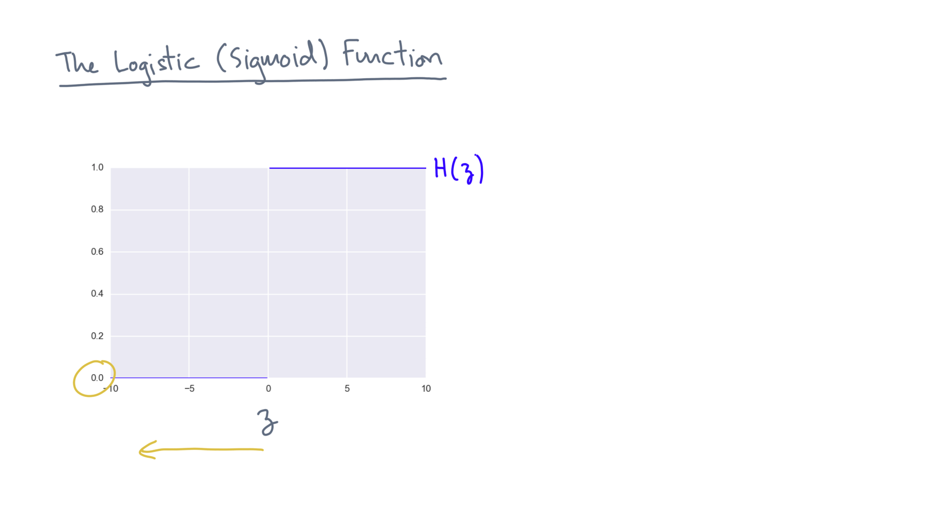
Notes:
It maps negative values to 0…

Slide 11
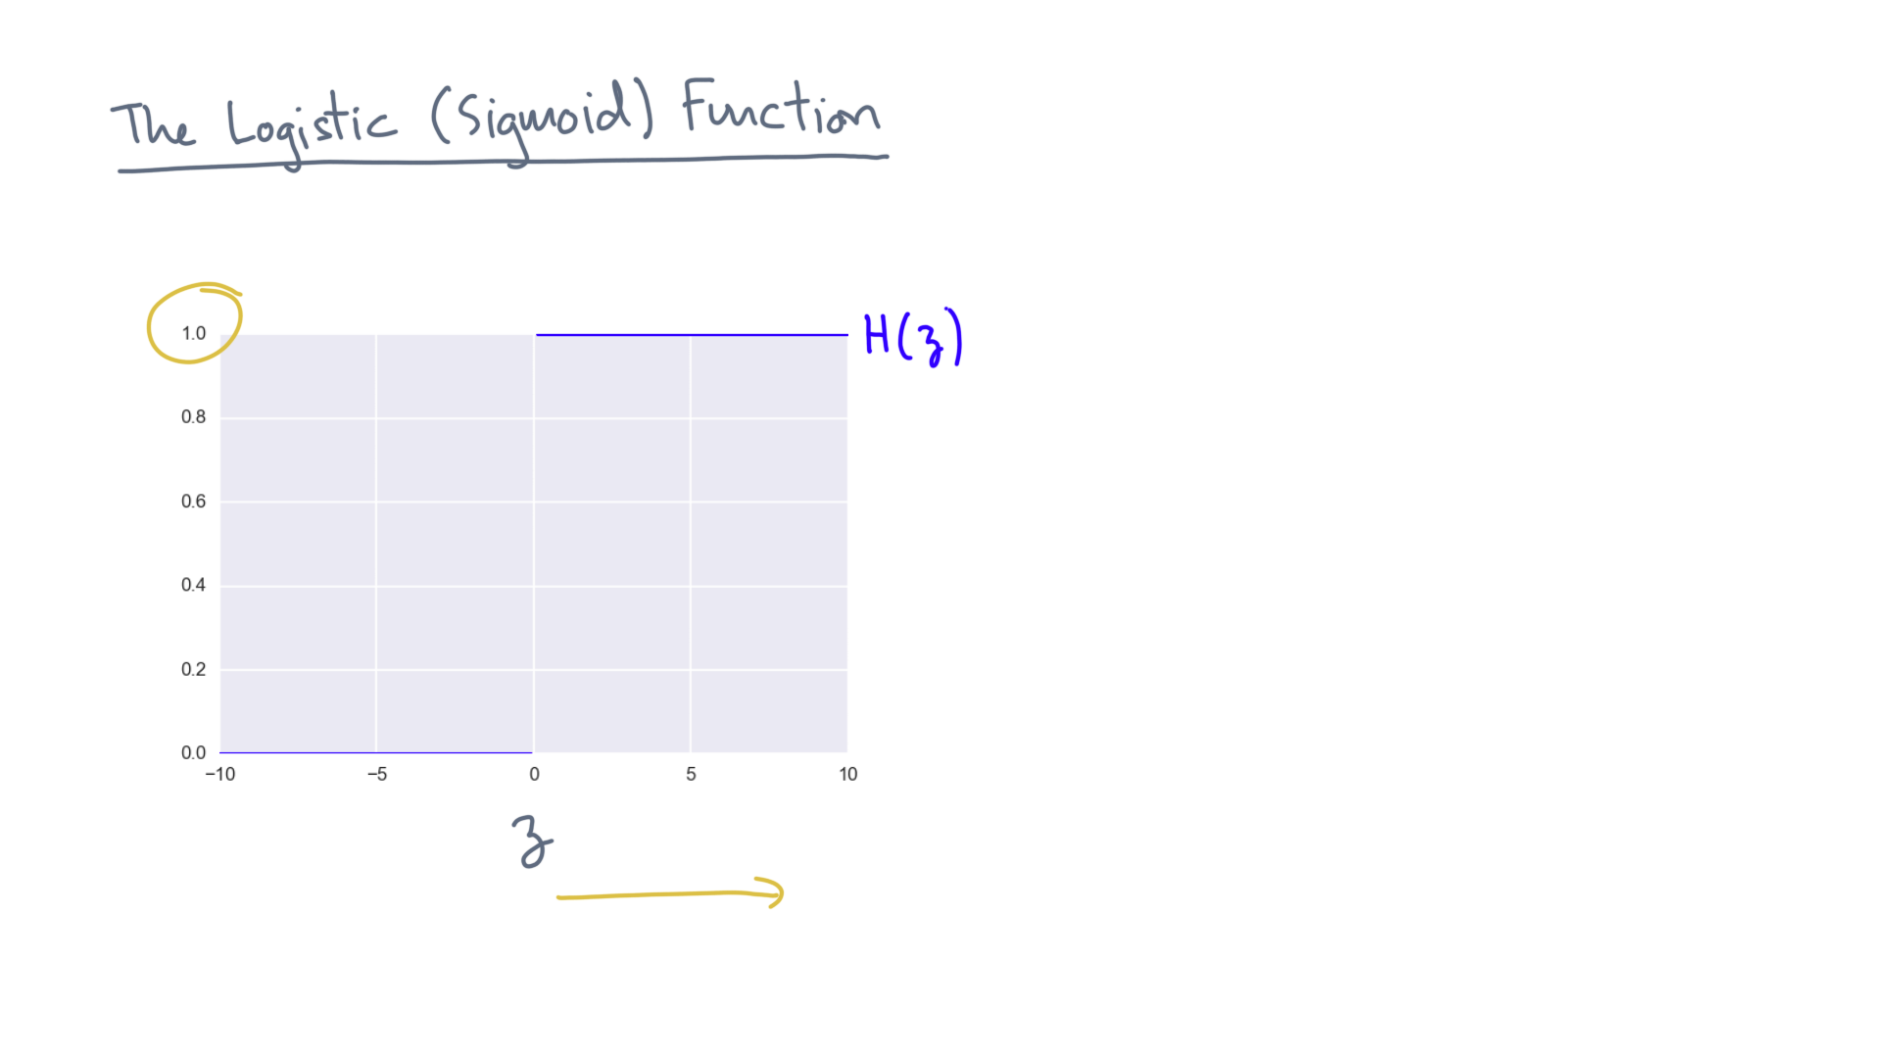
Notes:
… and it takes positive values to 1.0.

Slide 12
Notes:
Here is an alternative.

Slide 13
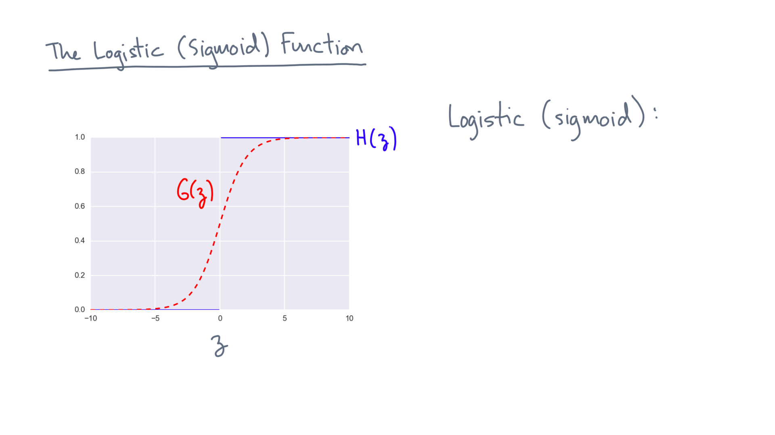
Notes:
It’s called the logistic function, also known as the sigmoid function because it looks like the letter “s”.

Slide 14
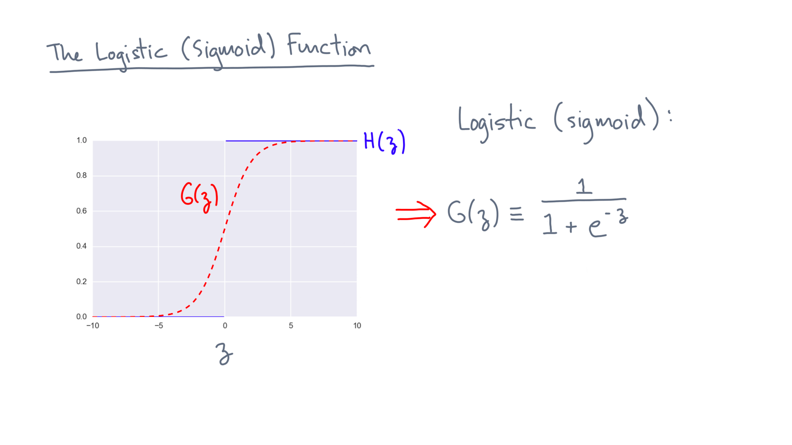
Notes:
Let’s denote it by capital-G of z.
It’s defined to be one divided by the quantity 1 plus e to the minus z.

Slide 15
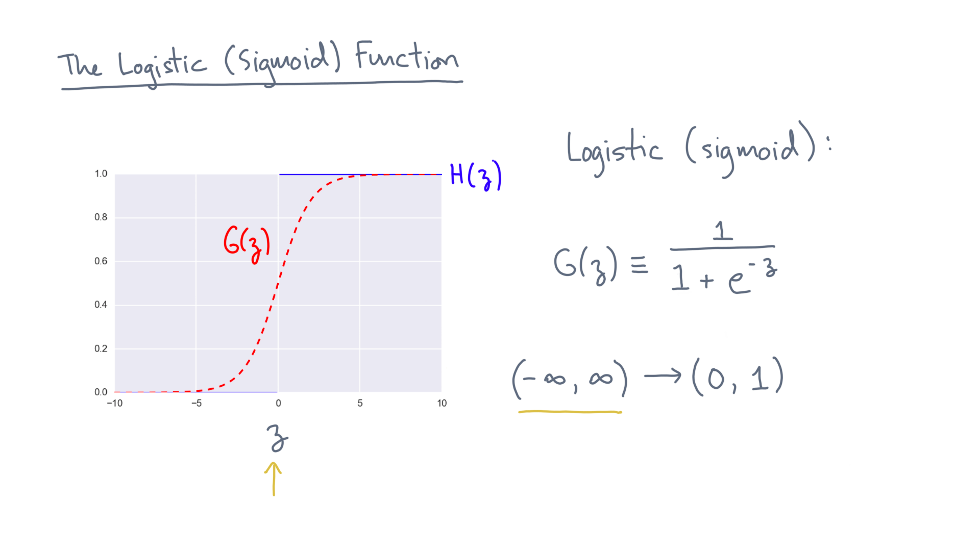
Notes:
Its domain is minus infinity to plus infinity.

Slide 16
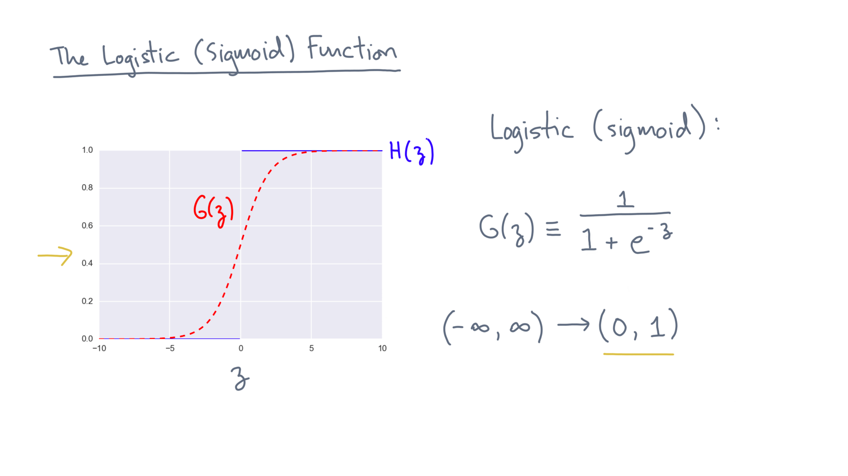
Notes:
It maps these values into the range zero-one.

Slide 17
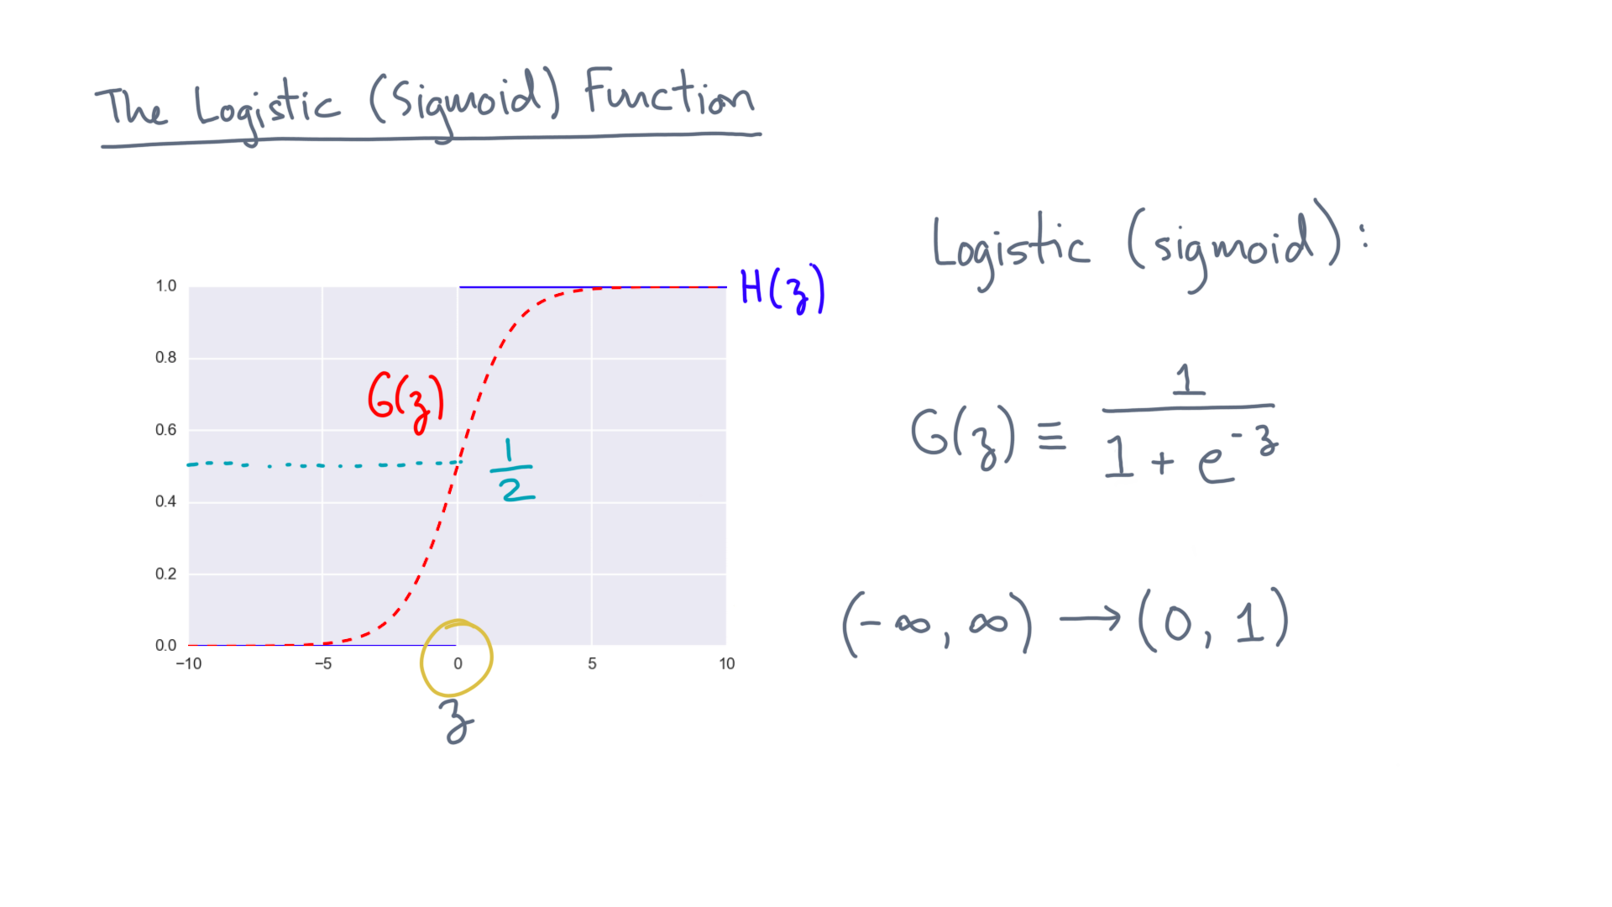
Notes:
And G(zero) is one half.

Slide 18
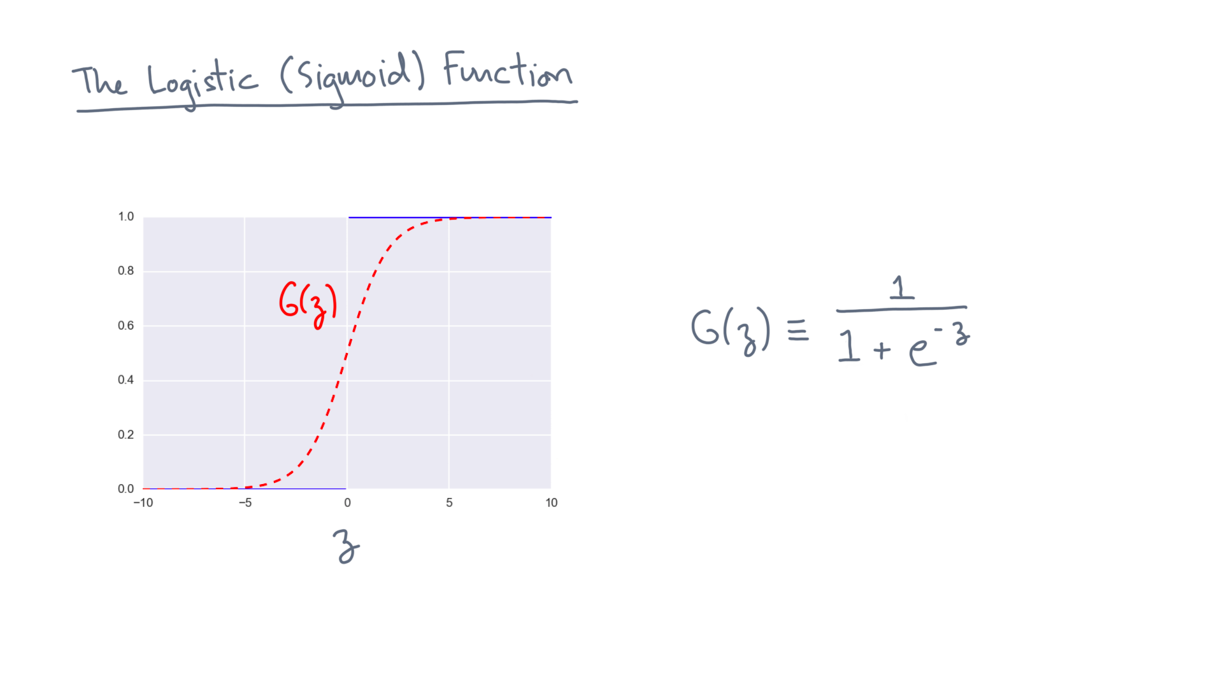
Notes:
Now the zero-one mapping is especially convenient because it suggests you can interpret the function as a probability.

Slide 19
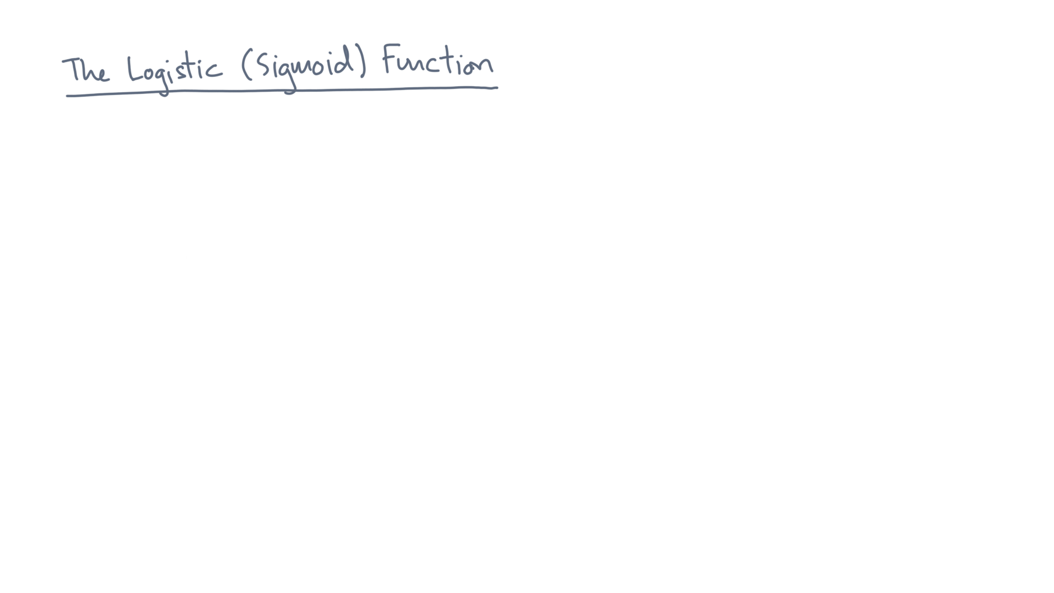
Notes:
In fact, that reminds me of an interesting property of sigmoids.

Slide 20
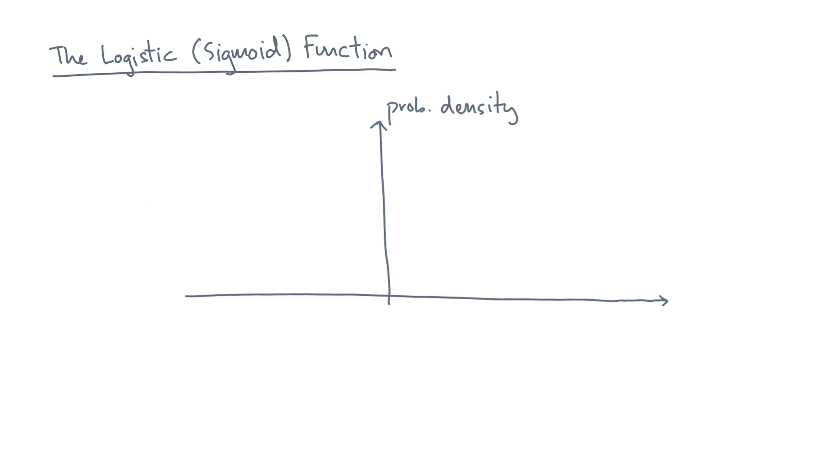
Notes:
Consider the probability density of some distribution.

Slide 21
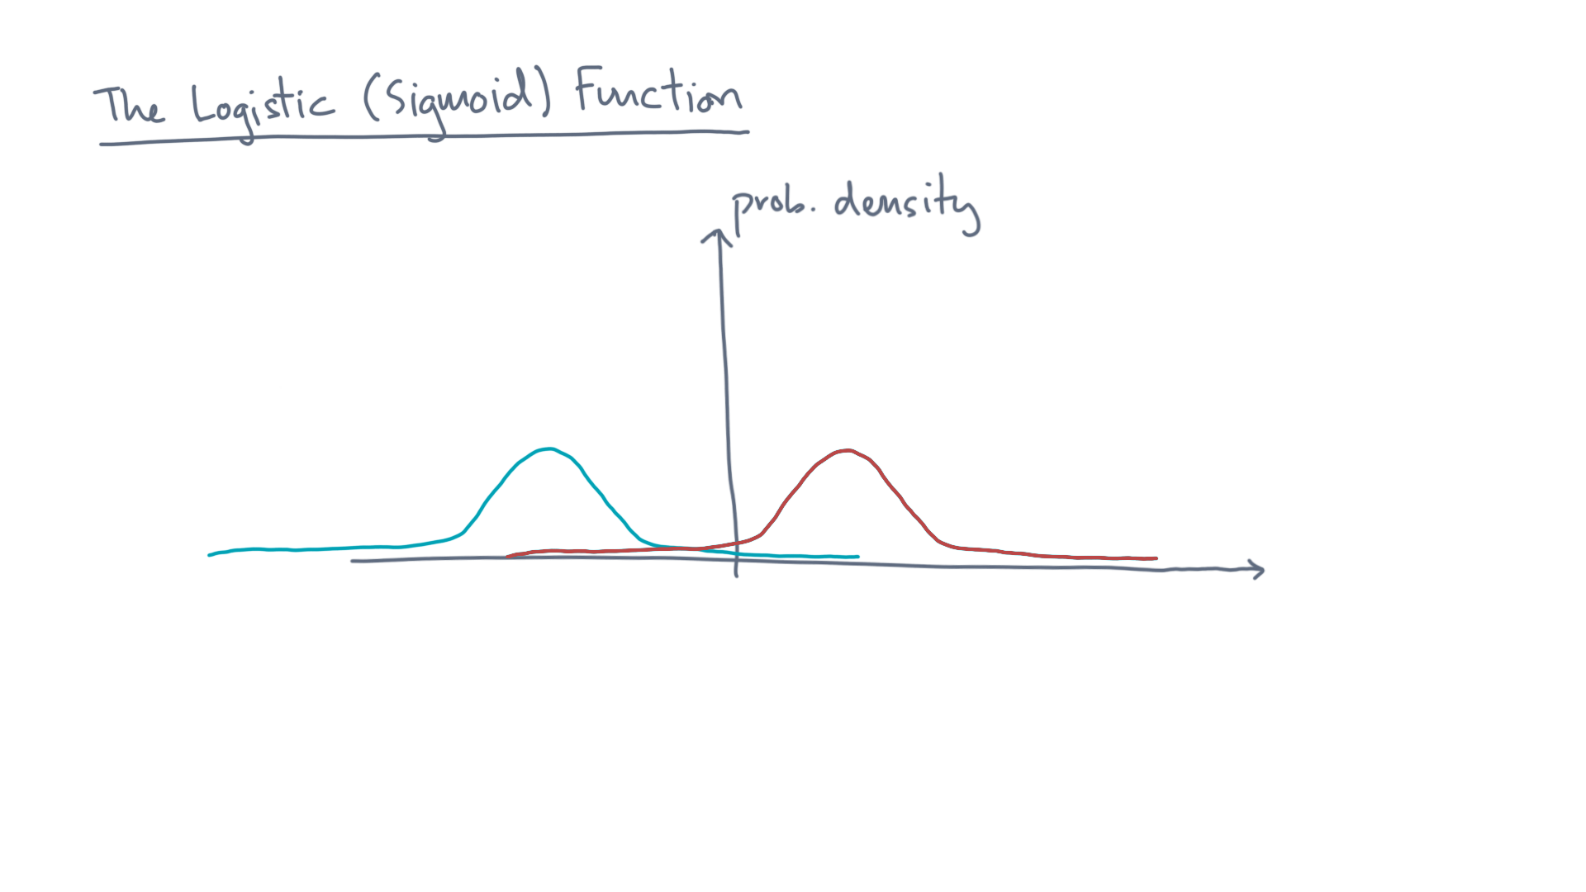
Notes:
Suppose this density is the combination of two normal, or Gaussian, distributions.

Slide 22
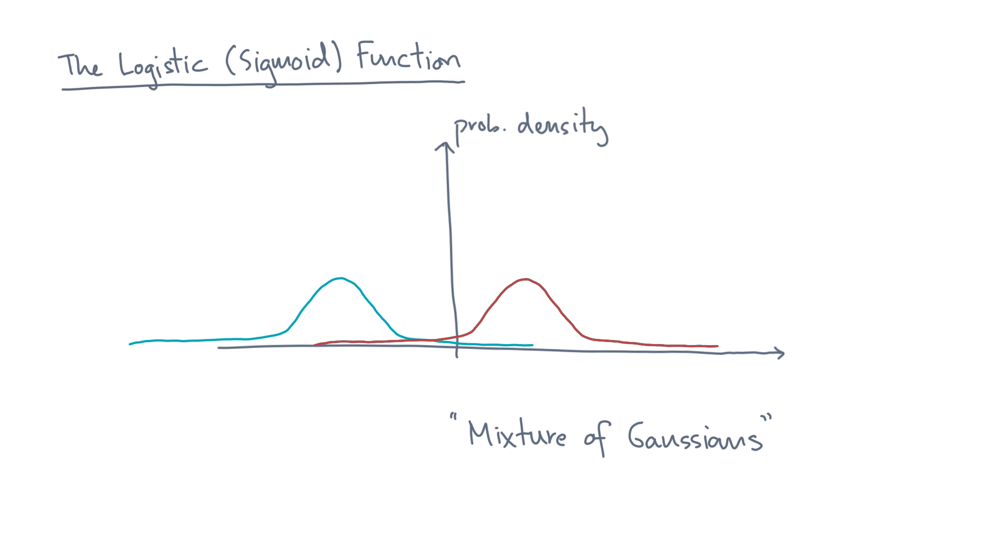
Notes:
This is sometimes referred to as a “mixture of Gaussians.”

Slide 23
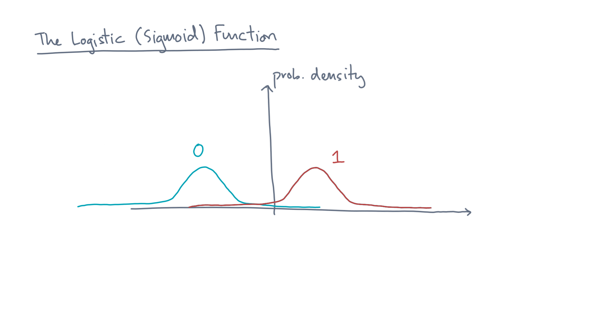
Notes:
Think of this distribution as one that generates labeled zero-one points.

Slide 24
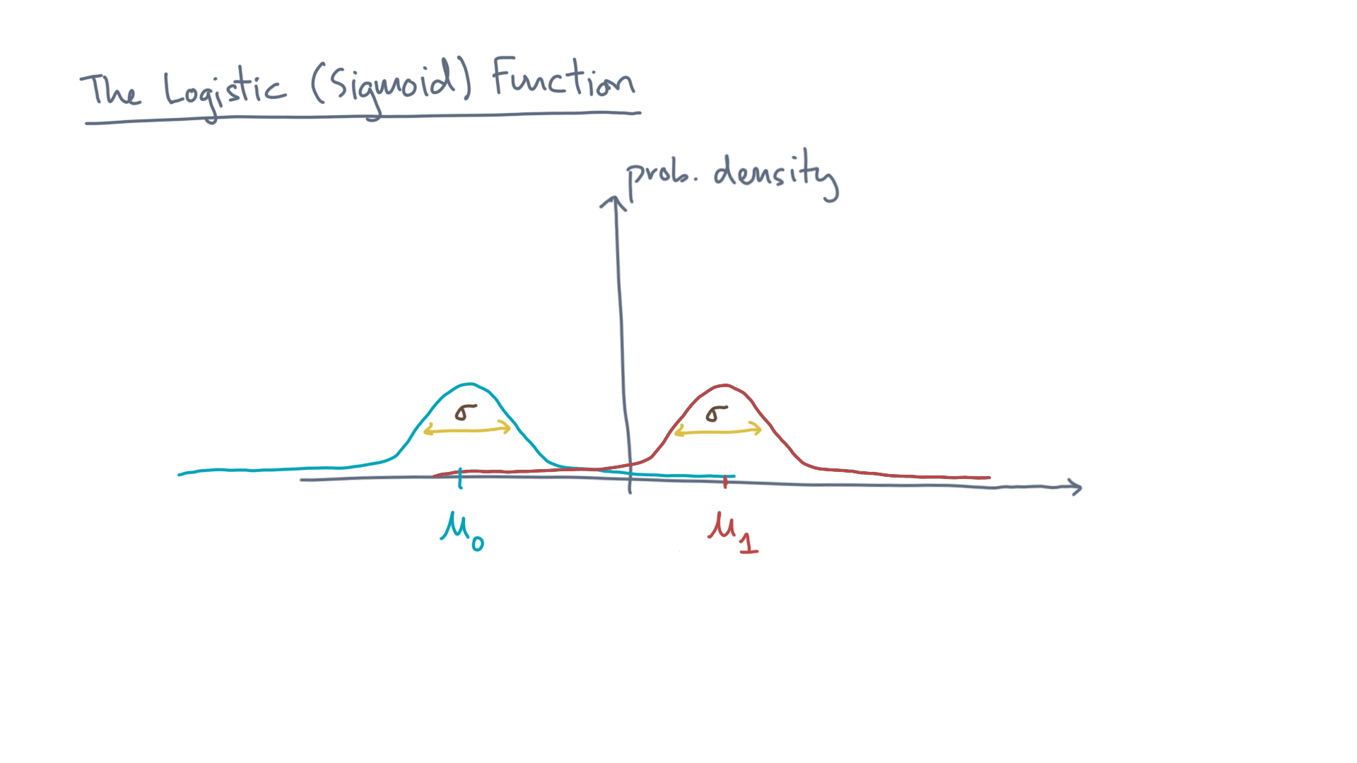
Notes:
Now suppose these distributions have different means but the same variance.

Slide 25
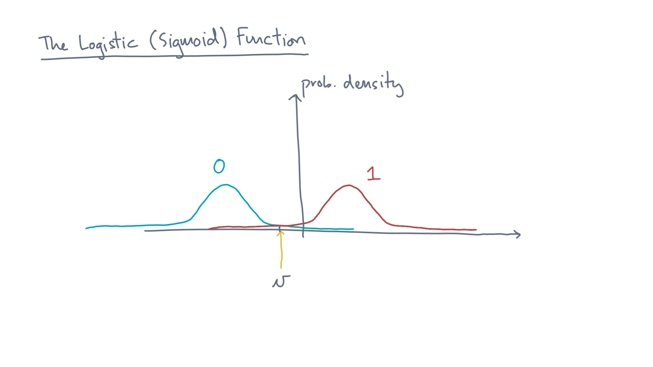
Notes:
Now consider some value “v” drawn from this distribution.

Slide 26
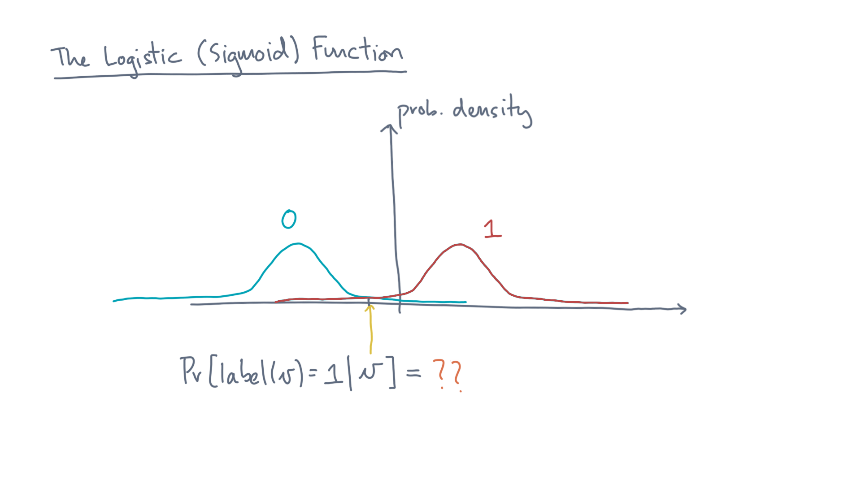
Notes:
What is the conditional probability that its label equals 1, given the value?

Slide 27
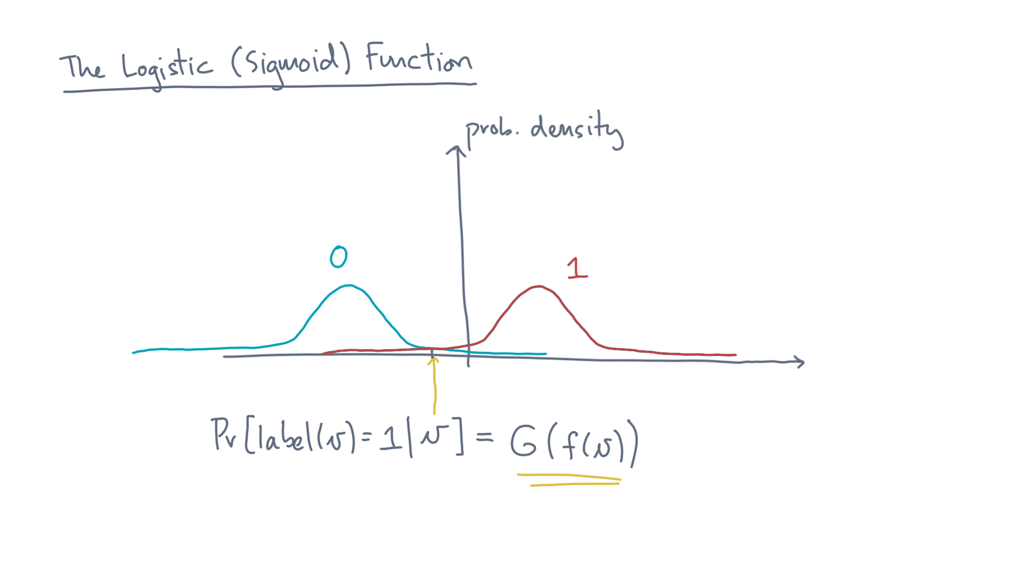
Notes:
It turns out it’s given by the logistic function!
Later, I’ll ask you to do an exercise to see how.

Slide 28
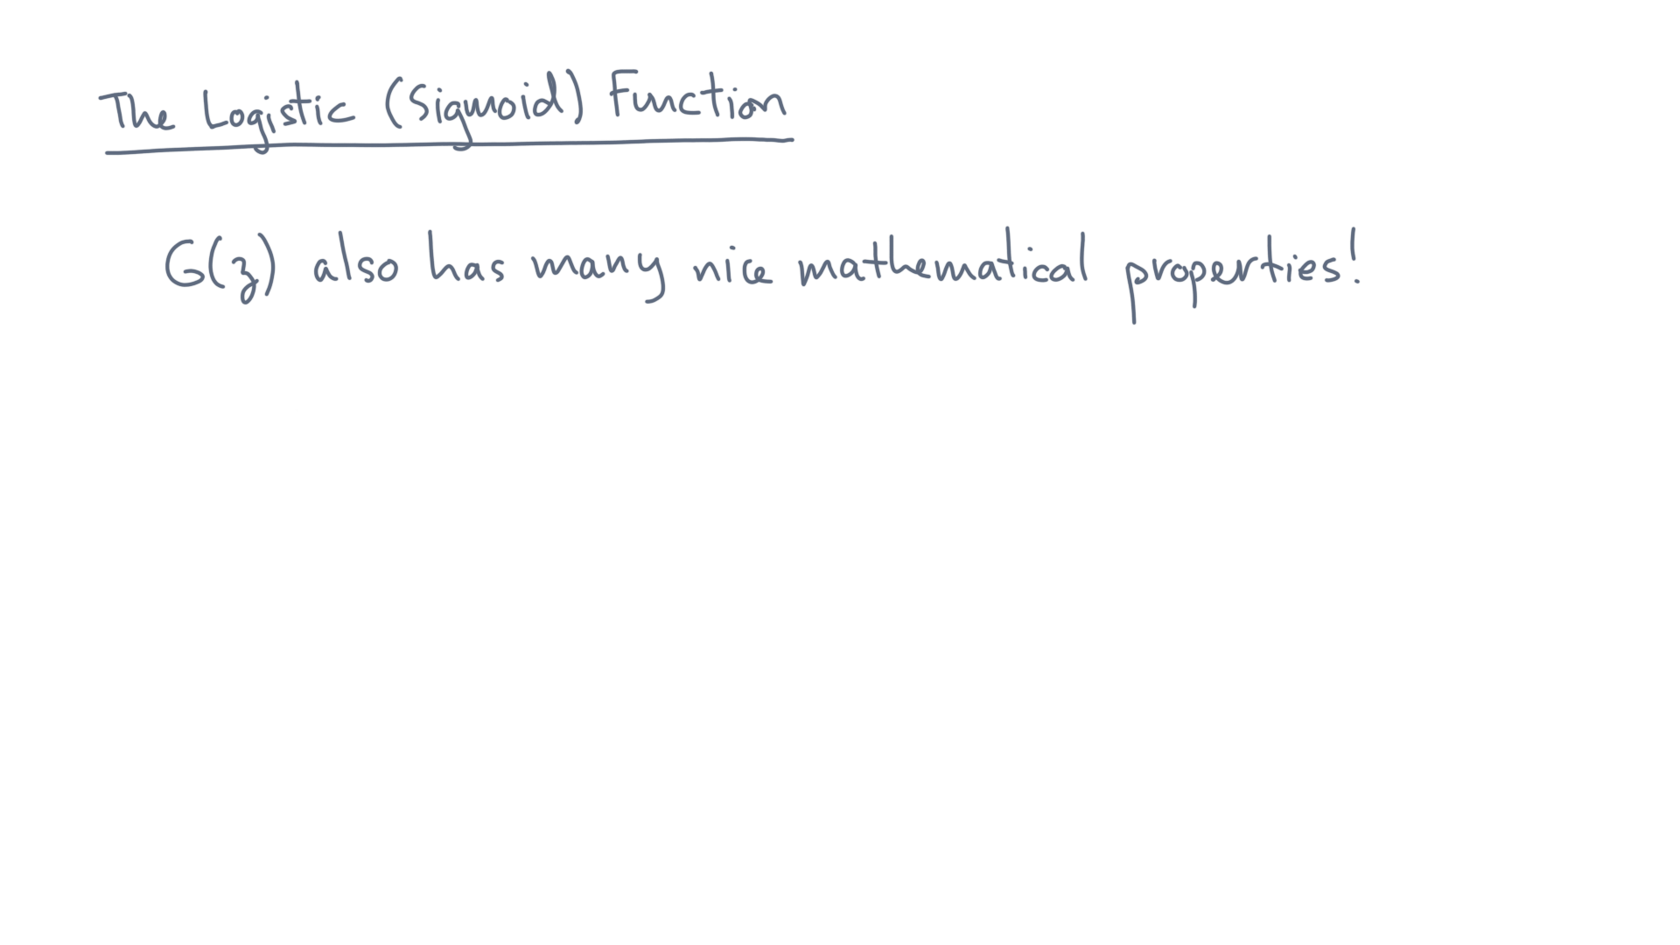
Notes:
It also turns out the logistic function has many nice mathematical properties, which will greatly simplify the design of a classification algorithm.

Slide 29
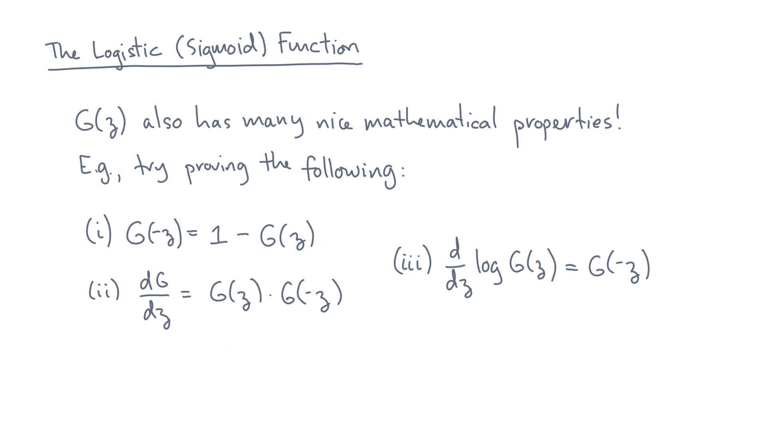
Notes:
Here are a few, which you might try to prove on your own.

Slide 30
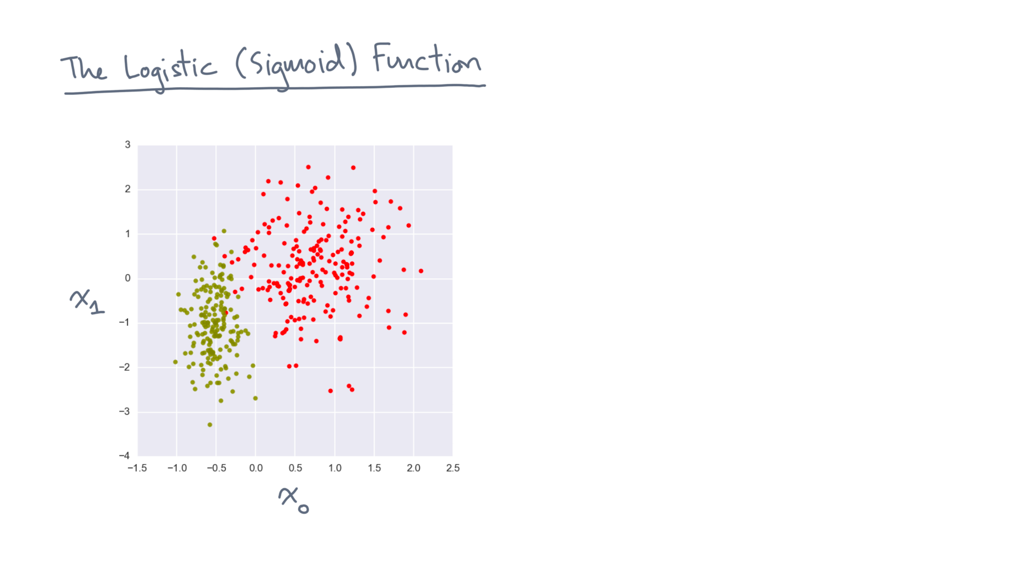
Notes:
Okay, so let’s apply the logistic or sigmoid function to our classification task.

Slide 31
Notes:
As before, let’s suppose we draw a linear discriminant through this space.

Slide 32
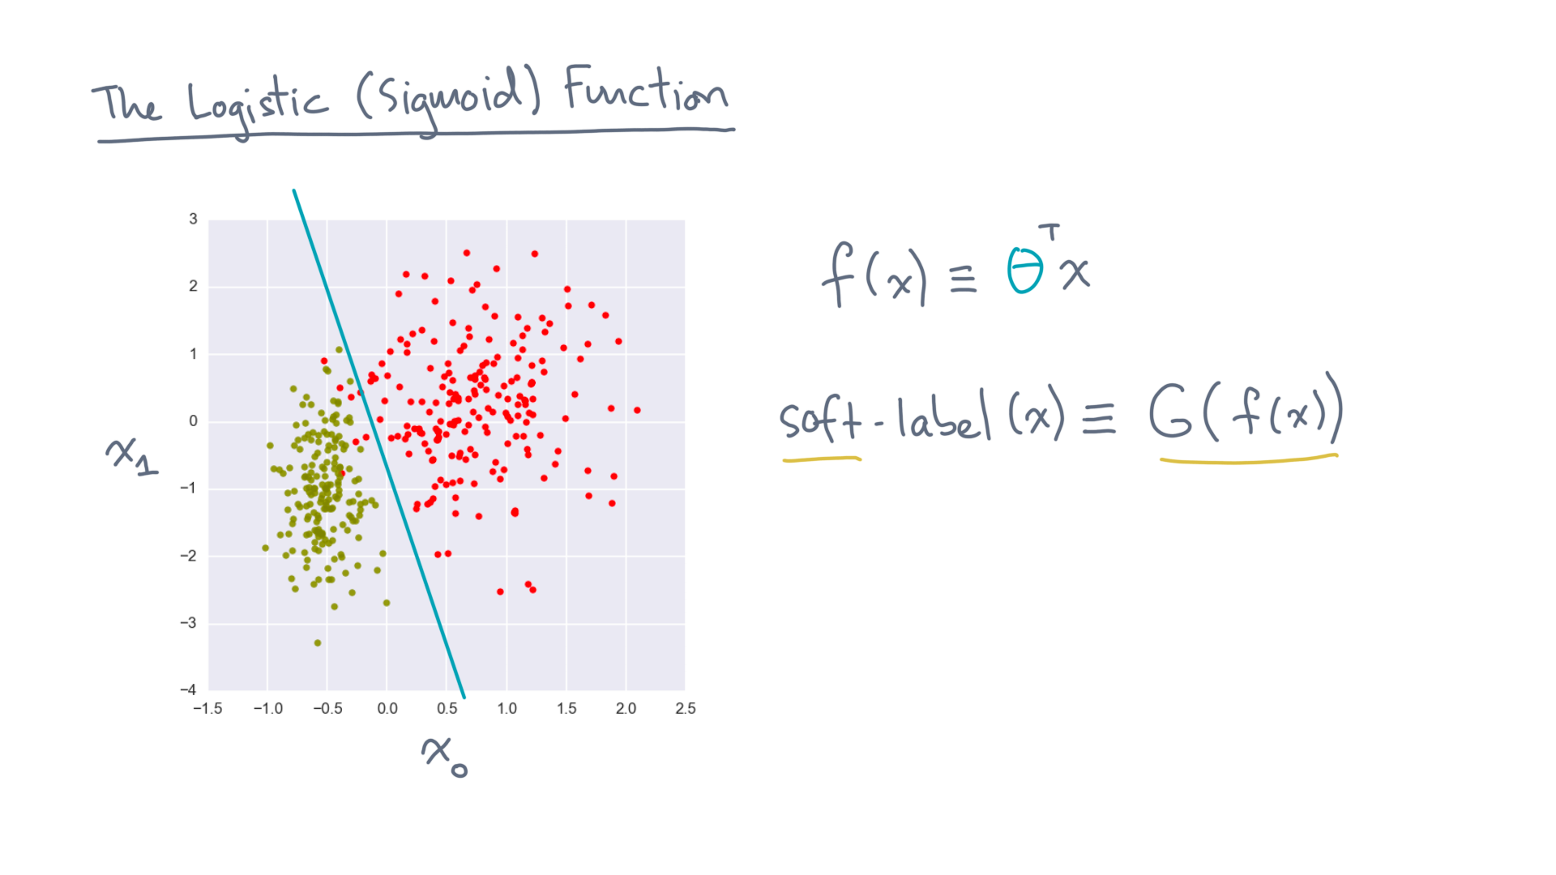
Notes:
We can generate a soft label to each point x by applying the logistic function instead of the Heaviside function.
That will give each point a fractional value between 0 and 1.

Slide 33
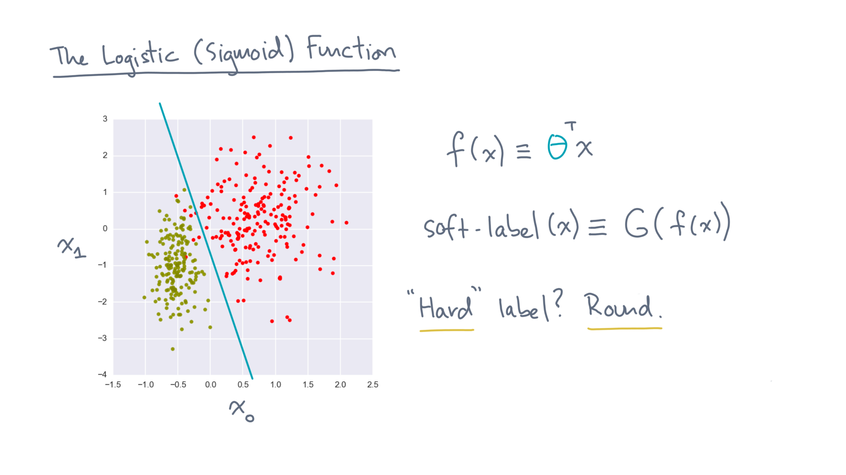
Notes:
And of course, if you need a hard label, you can always round this function in some way.

Slide 34
Notes:
So let’s recap where we stand.
For the classification task, we are using a linear discriminant function to assign points to a score.

Slide 35
Notes:
Given that score, you then have some options for how to generate a label.
For instance, you could use the Heaviside function, or you could use the logistic function, which was the main topic of this lesson.
These soft labels are helpful because in real world data, different classes will not be cleanly separable.

Slide 36
Notes:
What you should do now is take a look at a notebook we’ve prepared, which will help you do some exercises related to the logistic function.
Good luck! Don’t forget to use the forums if you get stuck, and we’ll see you in the next lesson.

